Slide 1
Capstone Project:
Converting Grayscale Images to RGB Using Intuitionistic Fuzzy Sets AND Intuitionistic Fuzzy Entropy:

Slide 2
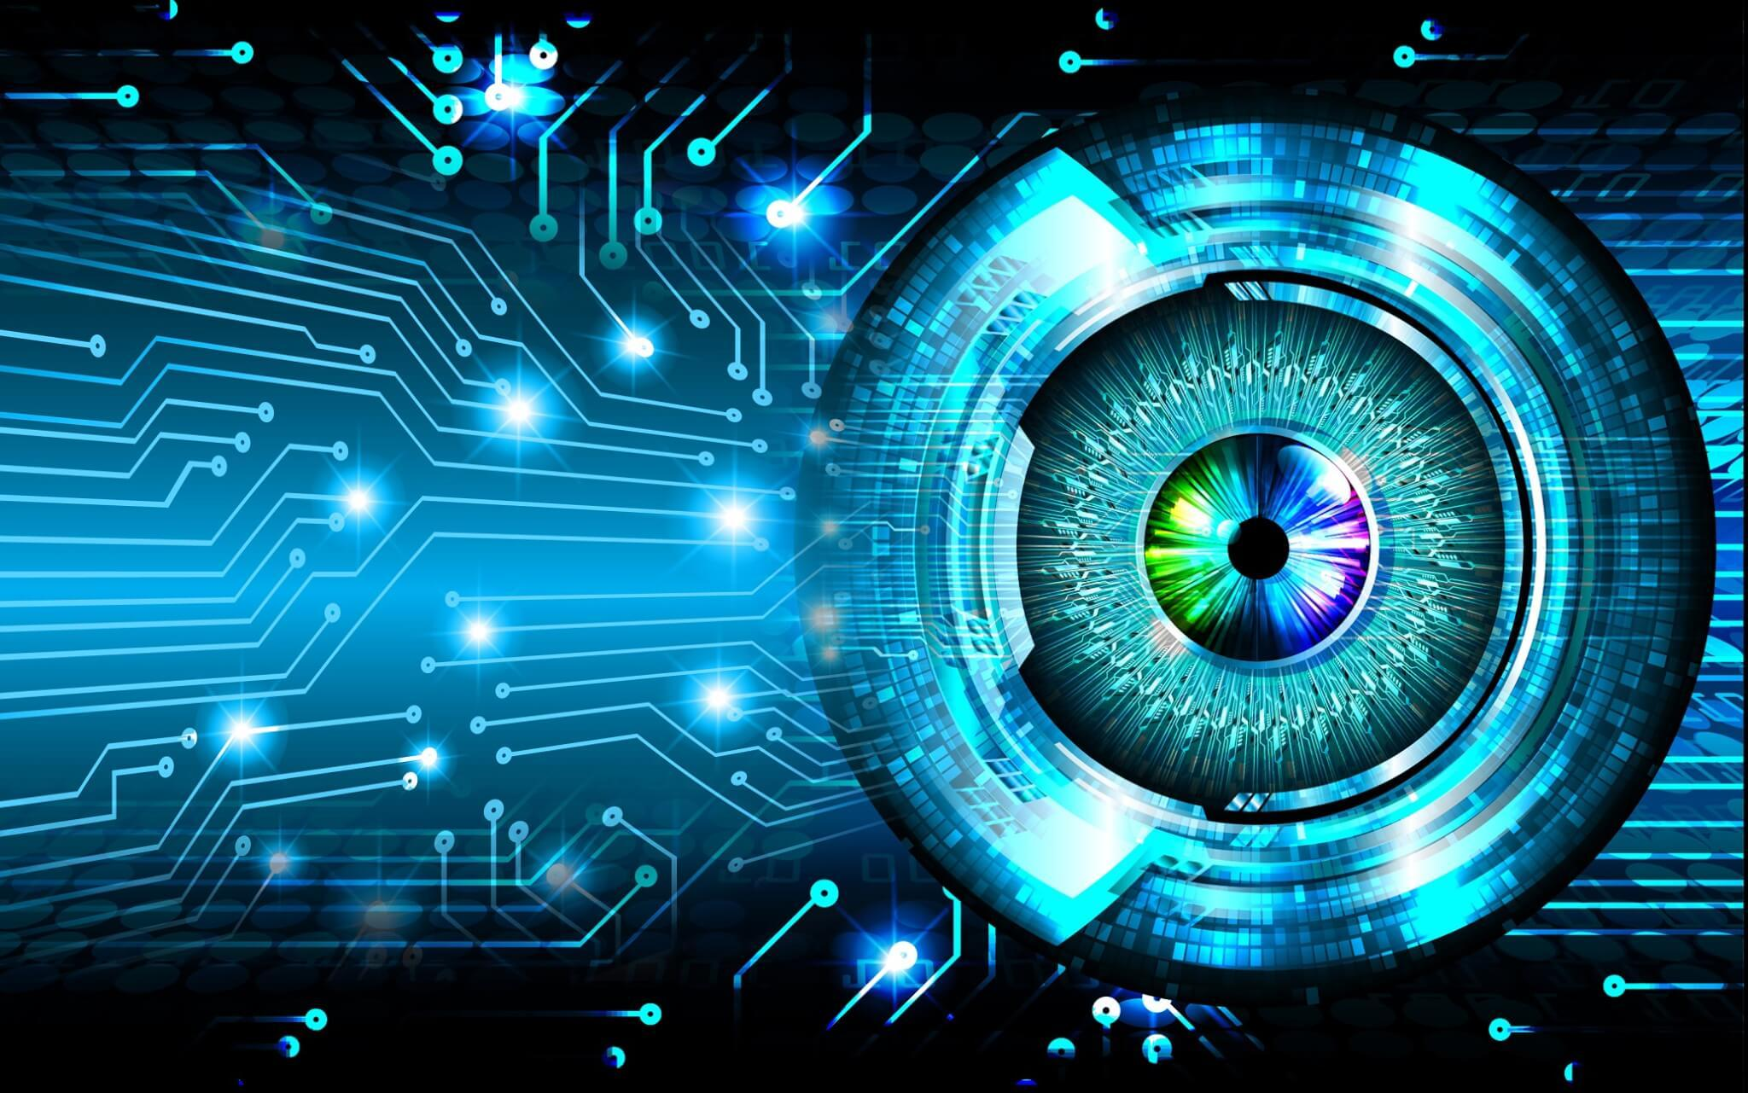
Introduction:

Slide 3
COMPUTER VISION
"Imagine a world where machines can see and understand the way we do, opening doors to endless possibilities. This is the realm of computer vision."

Slide 4
The Importance of Computer Vision
"Computer vision is not just a technological advancement; it's a revolution. It's transforming the way we interact with our environment and the way machines interact with us.“
"computer vision plays a pivotal role in the development of autonomous vehicles, making our roads safer and transportation more efficient.“
"The applications of computer vision extend beyond industry and into our everyday lives, from the facial recognition systems securing our smartphones to the security cameras keeping our homes and businesses safe."

Slide 5
Project Introduction
Title: Transforming Grayscale Images to RGB Using Intuitionistic Fuzzy Logic
Our Unique Application of Computer Vision
Our project represents a unique and innovative application of computer vision technology. While computer vision is widely known for tasks like object detection and facial recognition, our project takes a different and interest path.

Slide 6
What Sets Us Apart:
From Gray to Color: Unlike traditional computer vision applications, our project focuses on taking grayscale images, those devoid of color, and transforming them into vibrant and realistic color representations. This is a departure from the usual objective of recognizing and interpreting visual data.
The Power of IFIs and IFE: The core of our uniqueness lies in our utilization of Intuitionistic Fuzzy Images (IFIs) and the computation of Intuitionistic Fuzzy Entropy (IFE). These advanced concepts add a layer of complexity and sophistication to our project, setting it apart from typical computer vision endeavors.

Slide 7
PROBLEM STATEMENT
The problem statement of our project can be framed as follows:
"Develop a method for enhancing grayscale images by converting them into Intuitionistic Fuzzy Images (IFIs) and applying a color mapping scheme based on intuitionistic fuzzy entropy. This method aims to improve the visualization of complex or uncertain data by highlighting regions of interest and uncertainty in the images specially in x-ray images ."

Slide 8
OBJECTIVES AND OUTCOMES
our project's primary application seems to be in image enhancement and visualization using intuitionistic fuzzy logic. Converting grayscale images to IFIs and applying color mapping based on entropy can be used in various fields, such as medical imaging, remote sensing, and data visualization. It can help to reveal more information and patterns in the data.

Slide 9
Data Collection:
From kaggle , google we collect data set

Slide 10
Methodology: Converting Grayscale Images to Intuitionistic Fuzzy Images (IFIs) and Calculating Intuitionistic Fuzzy Entropy (IFE)
In this section, we will dive into the intricate details of the methodology employed in our project. We'll elaborate on how we've successfully transformed grayscale images into Intuitionistic Fuzzy Images (IFIs) and the precise process of calculating Intuitionistic Fuzzy Entropy (IFE) for these images. These steps are central to our project and provide a deeper understanding of our innovative approach.

Slide 11
Converting Grayscale Images to Intuitionistic Fuzzy Images (IFIs):
Step 1: Initial Grayscale Images
We begin with a set of grayscale images, typically represented as matrices of pixel values ranging from black to white, where the absence of color conveys the absence of information about pixel membership in objects.
Step 2: Transformation to IFIs
The essence of our project lies in the transformation of these grayscale images into Intuitionistic Fuzzy Images (IFIs). An IFI extends the traditional grayscale representation by incorporating the concepts of membership, non-membership, and hesitancy.

Slide 12
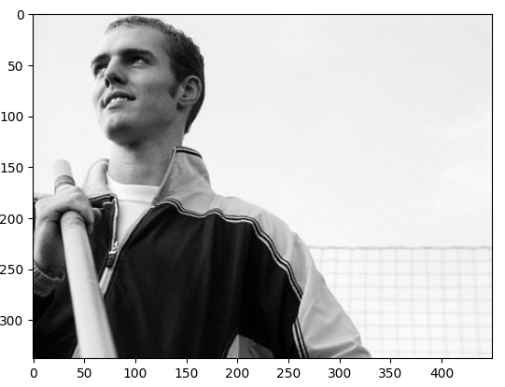
Gray image

Slide 13
Step 3: Membership and Non-Membership Calculation
For each pixel in the grayscale image, we compute its membership and non-membership values. These values represent the extent to which the pixel belongs to an object and does not belong to an object, respectively.
In the case of a pixel, membership (µ) may indicate the likelihood of it belonging to an object in the image, while non-membership (ν) denotes the likelihood of it not belonging to an object

Slide 14
Step 4: Hesitancy Calculation
The hesitancy (η) of a pixel is derived from the difference between non-membership and membership. It quantifies the uncertainty or hesitancy regarding the pixel's status.

Slide 15
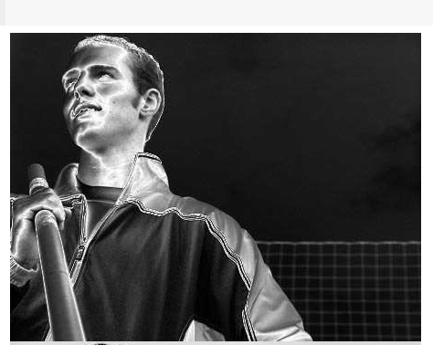

IFIs Image

Slide 16
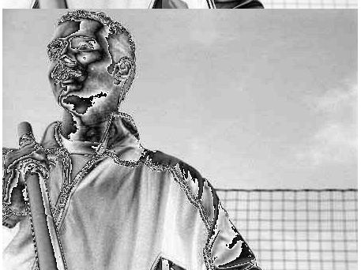
IFIs Image

Slide 17
Calculating Intuitionistic Fuzzy Entropy (IFE):
Step 1: Entropy as a Measure of Uncertainty
We use Intuitionistic Fuzzy Entropy (IFE) as a powerful metric to quantify the uncertainty associated with each pixel. It gauges the uncertainty, hesitancy, and the degree of completeness in the representation of the pixel within the IFI.
IFE is defined as E(x) = - [(µ * log₂(µ)) + (ν * log₂(ν))], where µ is membership and ν is non-membership.
The result is a measure that ranges from 0 (complete certainty) to 1 (complete uncertainty), providing an essential tool for understanding the information content of each pixel.

Slide 18
Contine..
Step 2: Hesitancy's Role
Hesitancy values become central in IFE calculations. They reflect the balance between membership and non-membership. A higher hesitancy value indicates greater uncertainty, while lower hesitancy implies greater clarity.

Slide 19
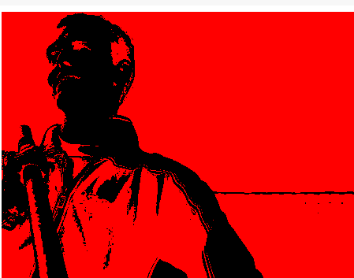

IFE Image

Slide 20
Feature Extraction in the Context of Grayscale to RGB Conversion Using IFIs and IFE
In this section, we will provide a comprehensive overview of the feature extraction techniques employed in our project. These techniques play a crucial role in our project's success, contributing to the conversion of grayscale images to RGB through Intuitionistic Fuzzy Images (IFIs) and the calculation of Intuitionistic Fuzzy Entropy (IFE).

Slide 21
Description of Feature Extraction Techniques:
Step 1: Edge Detection
Edge detection is one of the fundamental feature extraction techniques in our project. It is instrumental in identifying abrupt changes in pixel values, indicating the presence of object boundaries and image features.
Edge detection helps create well-defined regions within grayscale images, which is especially beneficial when transitioning to IFIs. These regions guide the membership and non-membership calculations, ensuring precise delineation of objects in the image.

Slide 22
Importance of These Features for Our Project:
The feature's capability to differentiate between object edges and background contributes significantly to the successful transformation of grayscale images into IFIs. These well-defined regions enable more accurate membership and non-membership calculations.
Edge detection enhances the interpretability of grayscale images by identifying essential boundaries and transitions between objects. This feature is pivotal for the conversion to IFIs, as it aids in defining the membership and non-membership values.
In summary, our feature extraction techniques are key components of our innovative project, providing the necessary data enrichment for an effective transition from grayscale to RGB through IFIs and IFE

Slide 23
Project Outcomes:
Vibrant Colorization: Our project successfully transformed grayscale images into vibrant RGB representations. By incorporating Intuitionistic Fuzzy Images (IFIs) and Intuitionistic Fuzzy Entropy (IFE), we achieved a dynamic and detailed colorization scheme.
Enhanced Image Quality: The use of feature extraction techniques, such as edge detection , significantly improved the quality of the colorized images.
Partial Membership Representation: One of the key outcomes was the ability to represent partial membership and uncertainty in the colorization process. Traditional methods often oversimplify the colorization by assigning a single color to each pixel, whereas our method allowed for the expression of partial membership, creating nuanced and more realistic color transitions.
Adaptive Color Mapping: The project incorporated a unique color mapping scheme based on Intuitionistic Fuzzy Entropy (IFE). This adaptability in color mapping set our approach apart from traditional methods, which typically use fixed color palettes.

Slide 24
THE END

